Slide 1
C0Ding Workshop Wk02: Yuta Nakayama

Slide 2
Quick Review:Week01
Design with Parameter / Algorithm
Constant / Variables (int, float, char, string)
Loop (for, while)
Conditionals (if-else, switch-case)
Function
(size(100,100); rect(10,10,20,20); )

Slide 3
int i = 10;

Slide 4
Value Assignment
int i = 10;
type
name
assignment operator
terminator
10
i

Slide 5
Value Types
int
i
-1, 0, 1, 2 …
float
f
0.5, 1.2, 2.4, -1.1 …
char
c
‘a’,’b’,’c’,…’1’,’2’…
string
s
“this”,”is”,”teh”,”tarik!”…

Slide 6
int [] a = { 3, 4, 5 };

Slide 7
Array
blanket
int [] a = { 3, 4, 5 };
Value 0
Value 1
Value 2
array type
name
3
4
5
a[ ] =
0
1
2

Slide 8
if-else
if( test ){
statements
}

Slide 9
if-else
if( test ){
statements
}
if
test
false
true
{ statements }

Slide 10
if-else
if( test ){
statements 1
}else{
statements 2
}
if
test
false
true
else
{ statements 1 }
{ statements 2 }

Slide 11
if-else
int n = 1;
if( n > 0 ){
rect(10,10,5,5);
}else{
ellipse(10,10,5,5);
}
if
n > 0
false
true
rect(10,10,5,5);
ellipse(10,10,5,5);

Slide 12
if-else
int n = 1;
if( n < 0 ){
rect(10,10,5,5);
}else{
ellipse(10,10,5,5);
}
if
n > 0
false
true
rect(10,10,5,5);
ellipse(10,10,5,5);

Slide 13
if-else if
if
if( test1 ){
statements 1
}else if( test2 ){
statements 2
}
false
test1
true
{ statements1}
test2
false
true
{ statements2}

Slide 14
while-loop
while( test ){
statements
}
while
test
false
true
loop
{
statements
}

Slide 15
while-loop
int n = 0;
while( n < 4 ){
println(n); //print n
n = n + 1; //add 1 to n
}
while
n < 4
false(n = 4)
true( n = 0,1,2,3)
rect(x,y,w,h);
n = n + 1;
Loop
4 times
result: 0 1 2 3

Slide 16
for-loop
for
1
2
3
1
init
for(init; test; update){
statements
}
false
test
2
true
{ statements
}
Loop
update
3

Slide 17
for-loop
for
1
i = 0
int i;
for(i = 0; i < 4; i = i + 1 ){
println(i);
}
1
2
3
false
i < 4
2
true
{ statements
}
Loop
4 times
result: 0 1 2 3
i = i + 1;
3

Slide 18
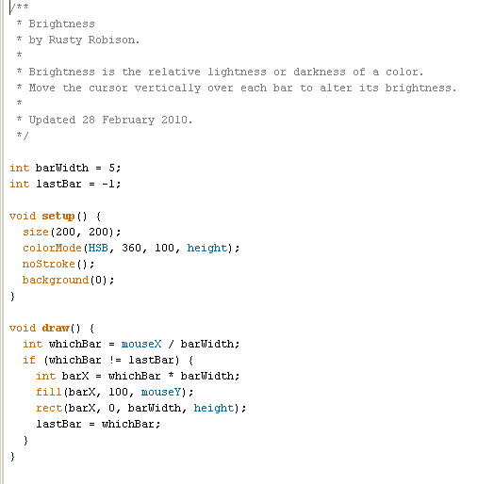
void setup() / void draw()?

Slide 19
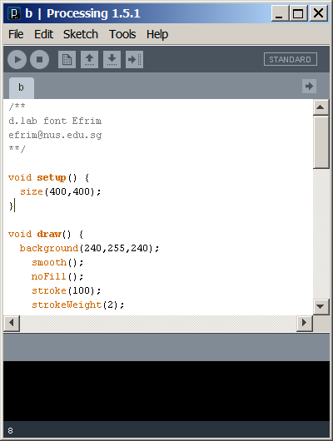
void setup() / void draw()?
Program Start
1
1
Initialize Global Variables
2
setup() function
(run once)
2
3
draw() function
(loop forever until the program stops.)
3

Slide 20
void?
void setup(){ size(400,400); int i = 10;
}

Slide 21
void: return nothing.
return value
function name
void setup( ){
size(400,400); int i = 10;
}
function block

Slide 22
Creating a function.
return value
function name
parameter1
parameter2
int aplusb(int A, int B){
int r;
r = A + B;
return r; }
Local Variable
function block
Return value statement.

Slide 23
Function()
4
5
int aplusb(int A, int B){
int r;
r = A + B;
return r; }
int i = aplusb(4,5); // i == 9
A
B
aplusb()
4 + 5
r
9

Slide 24
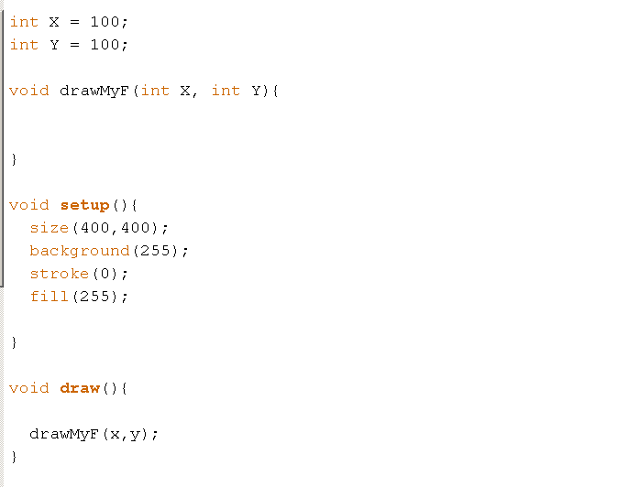
Ex: Create a function for your font drawing

Slide 25
Week02: Things to learn today.
Basic Electronics
(Tools/ LED/ Potentiometer)
Arduino Programming Basic
setup();/ loop();/
digitalWrite() /digitalRead()
analogWrite() / analogRead()
Sensor/Actuator modules
(Light/Touch/Pressure/Servo/DC motor)

Slide 26
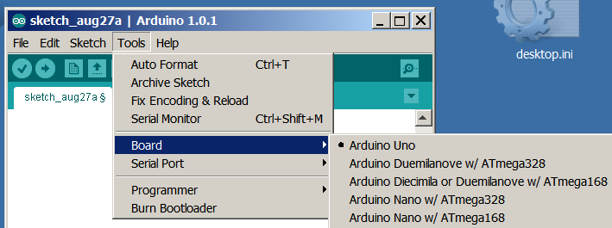
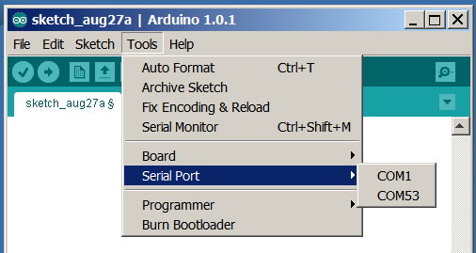
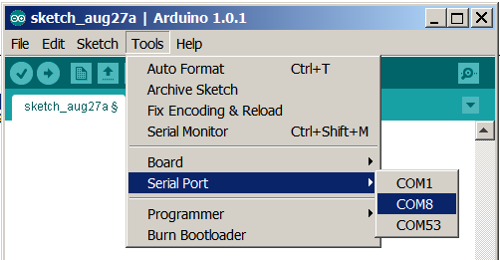
Setting up Arduino(windows)
Install Arduino Software & Driver (http://arduino.cc)
Select a type of Arduino board “Arduino Uno”
Unplug and re-insert the USB cable and select the Port appeared.
Open Sketchbook -> Examples -> Digital -> Blink

Slide 27
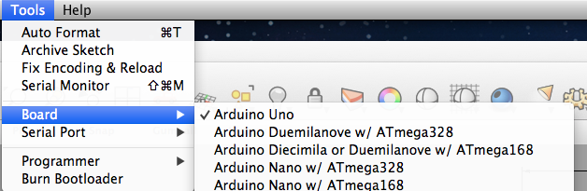
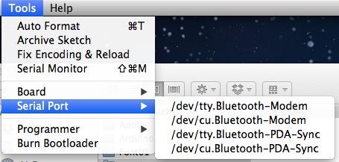
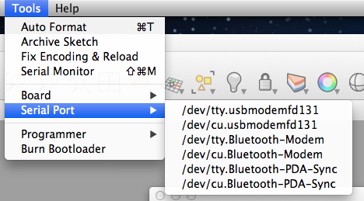
Setting up Arduino(mac)
Install Arduino Software & Driver (http://arduino.cc)
Select a type of Arduino board “Arduino UNO”
Unplug and re-insert the USB cable and select the Port appeared (/dev/tty.****).
Open Sketchbook -> Examples -> Digital -> Blink

Slide 28
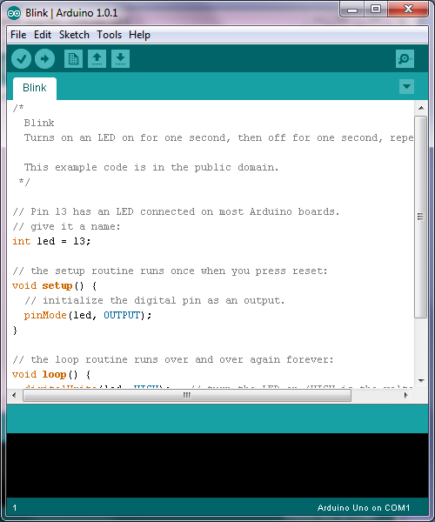
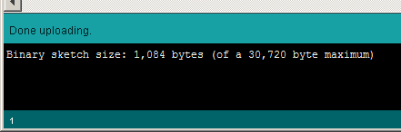
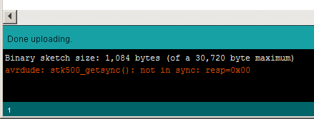
Running Arduino Code
Success:
1.Compile
2. Upload
Fail:
3. Message
avrdude: stk500_getsync(): not in sync: resp=0x00

Slide 29
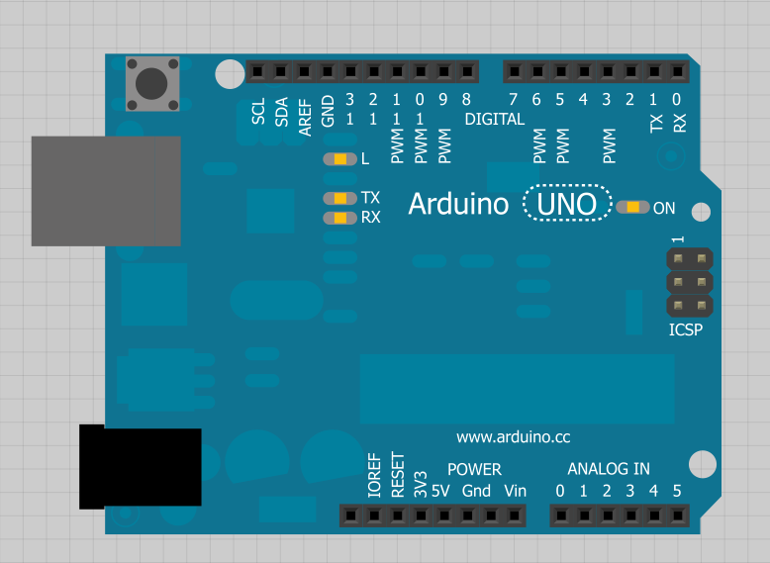
Arduino Board
Digital Input/Output
Reset Button
USB Jack
Power LED
TX+RX monitor LEDs
Power Jack
Power Pins
Analog Input

Slide 30
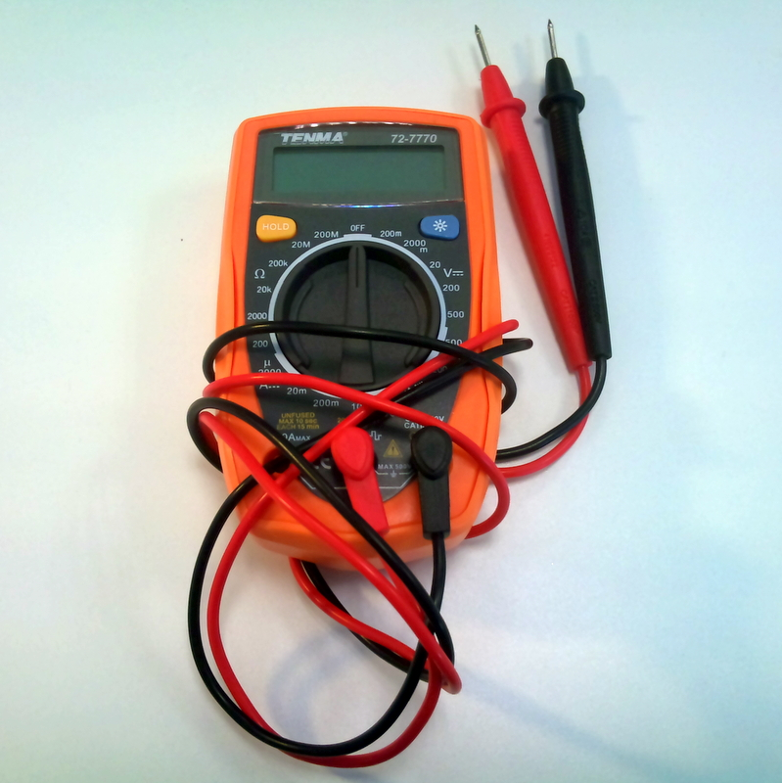
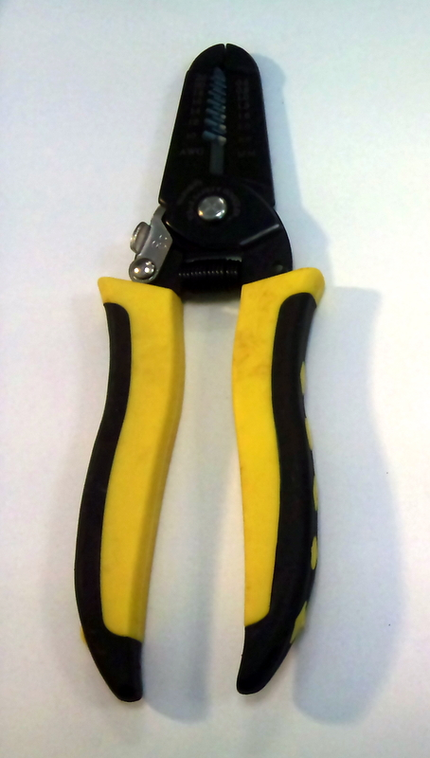
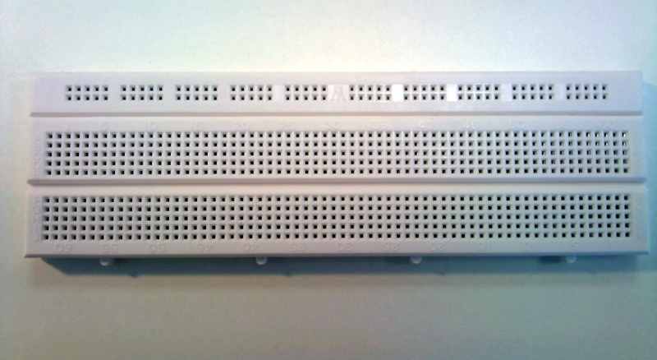
Basic Tools
Multi-meter
Cable Stripper
Breadboard

Slide 31
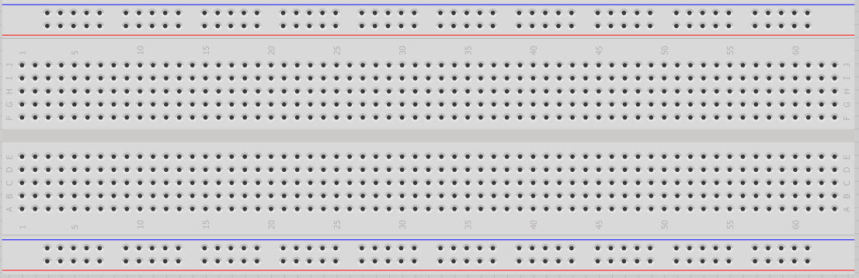
Solderless Breadboard
A breadboard is a reusable construction base for prototyping of electronics.
No soldering -> insert wire / components
Reusable/ Easy to change connections
Power Rail1
Columns 1
Columns 2
Power Rail2
Electrical Connection

Slide 32
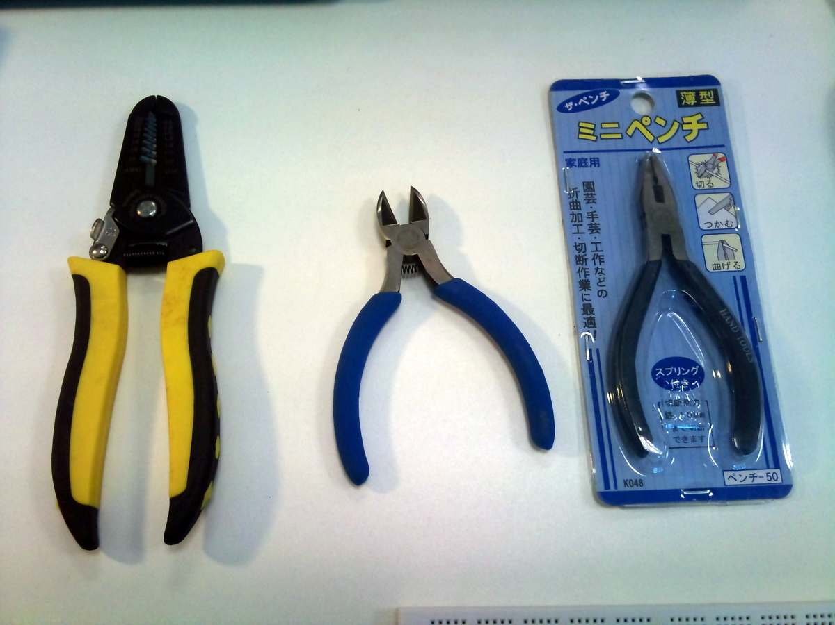
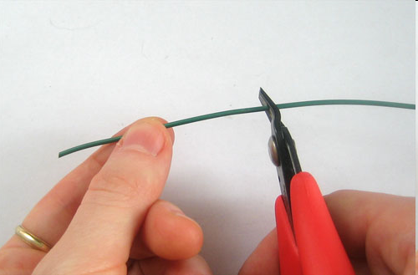
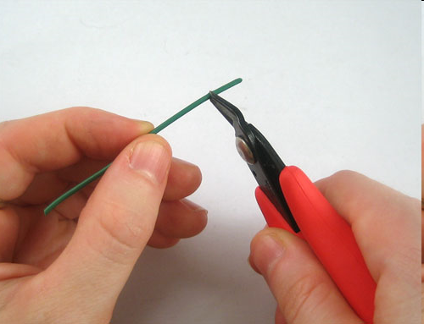
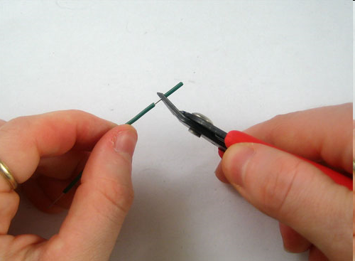
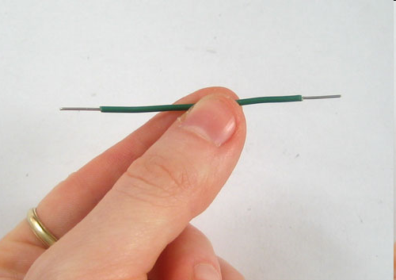
Wire Stripper

Slide 33
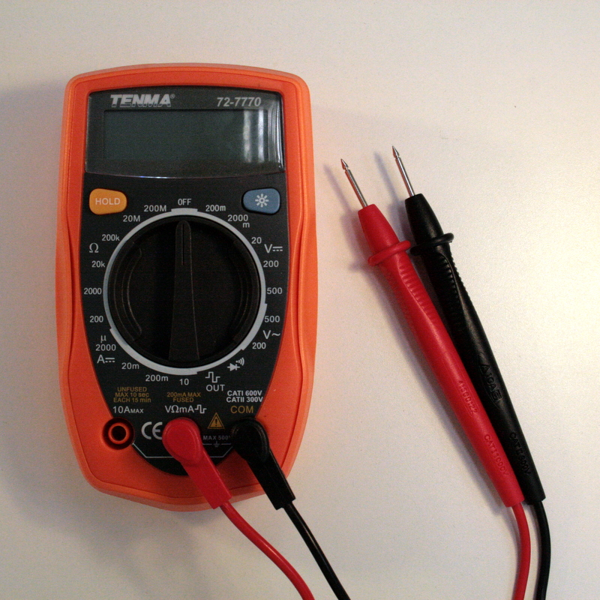
Multimeter
Resistance (Ω)
DC Voltage (V)
AC Voltage (V)
DC Current (A)
Continuity Test
Diode Test

Slide 34
Multimeter
Hold Button
Resistance Test
DC Voltage Test
AC Voltage Test
DC Current Test
Continuity Test
Diode Test

Slide 35
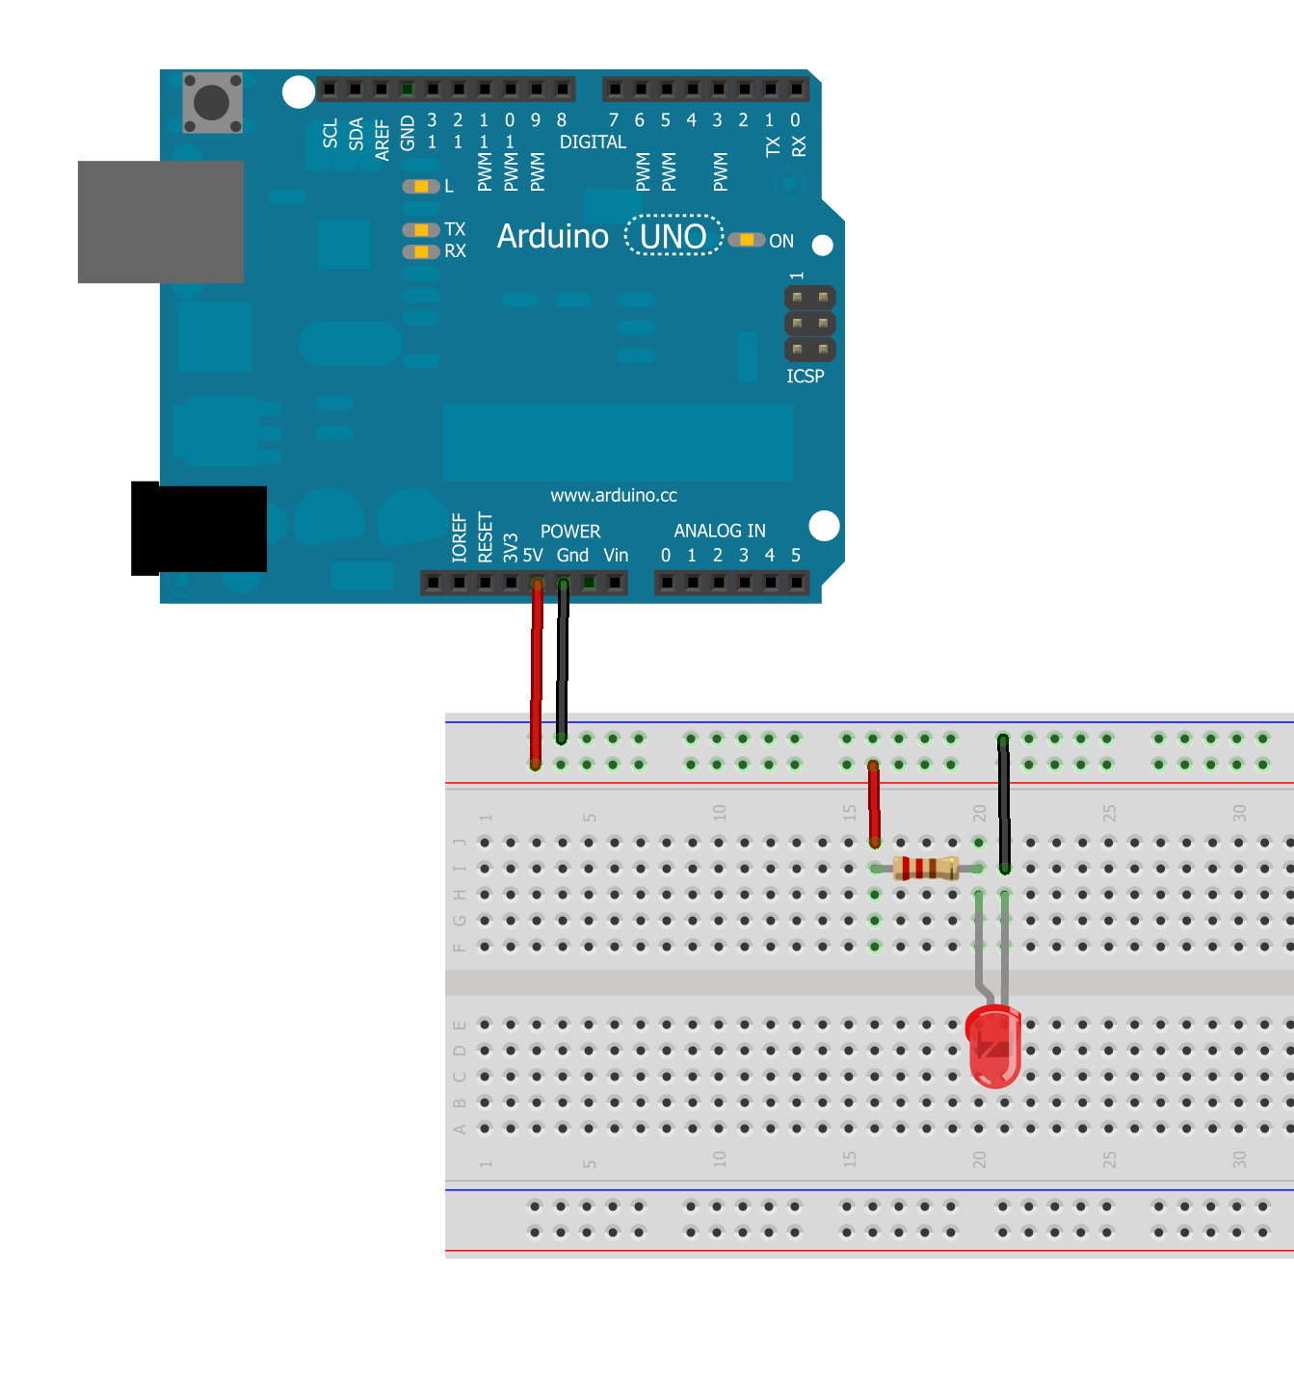
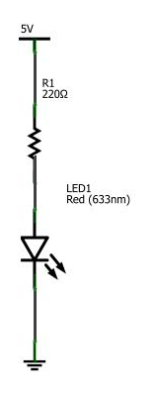
LED1:: My 1st LED Circuit
Power +5v
Resistor
LED
GND

Slide 36
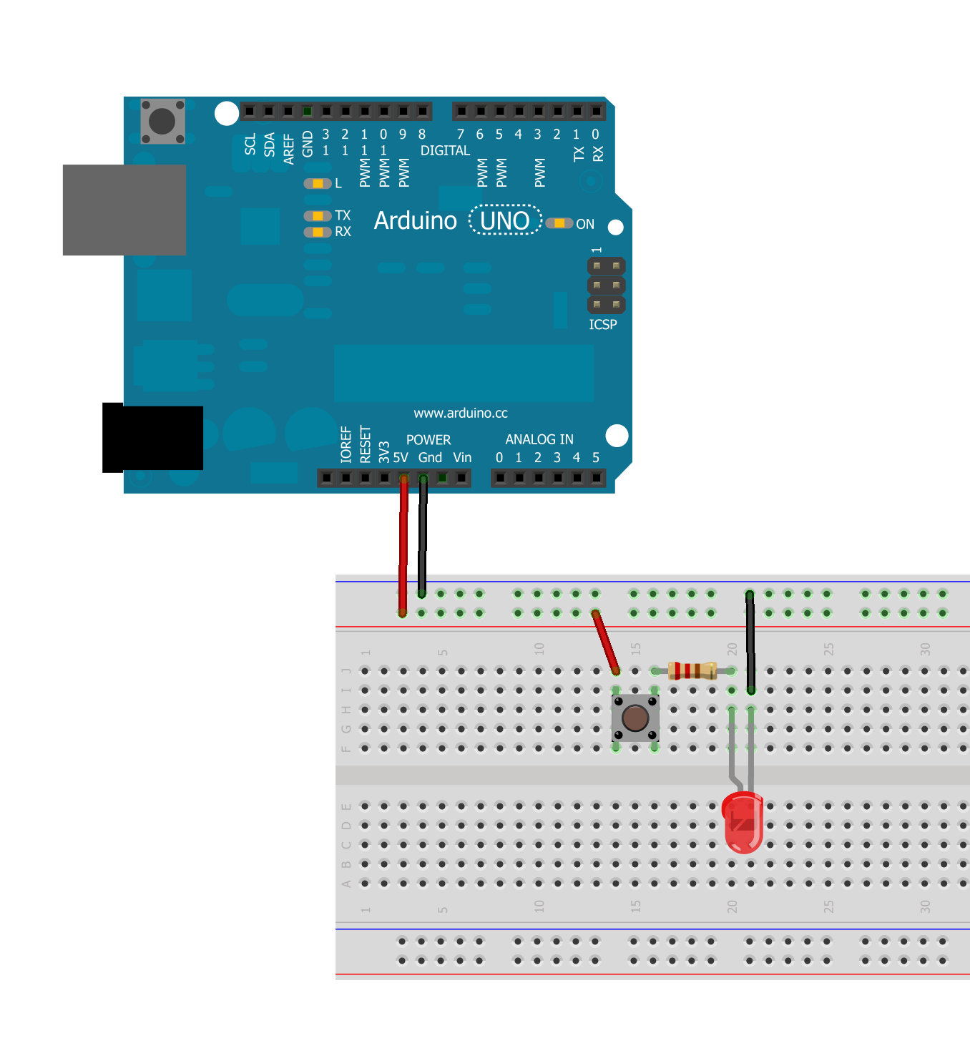
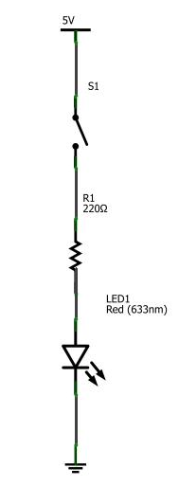
LED2: LED + push button
Button

Slide 37
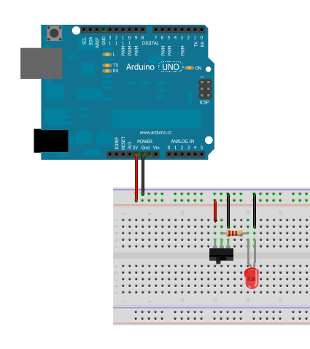
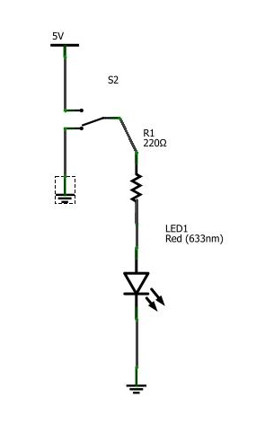
LED2-1: Switch
Replace the button with a switch

Slide 38

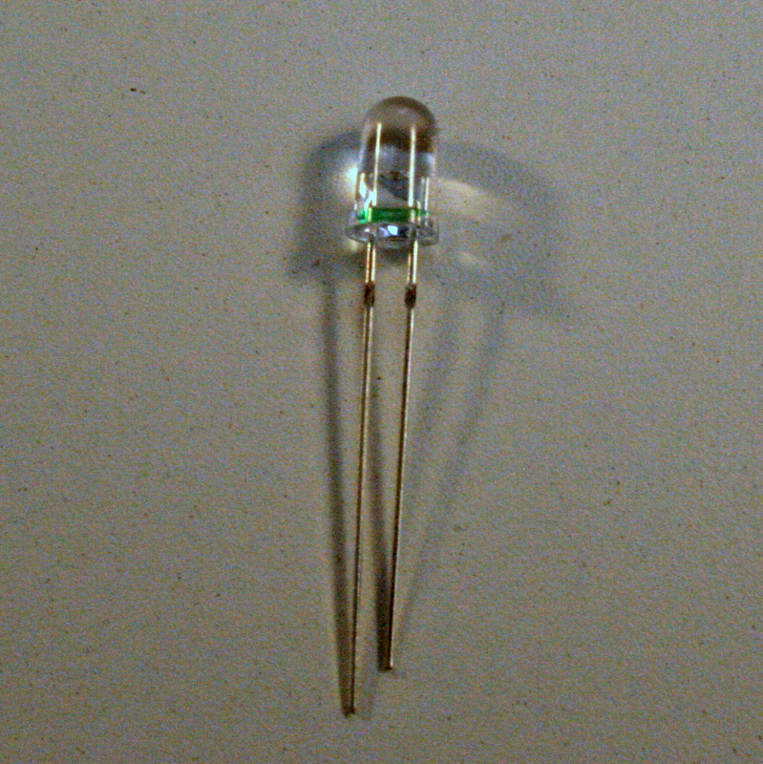
LED: Light Emitting Diode
Anode(+)
Cathode(-)
Shorter lead
Anode(+)
Longer lead
Anode(-)

Slide 39
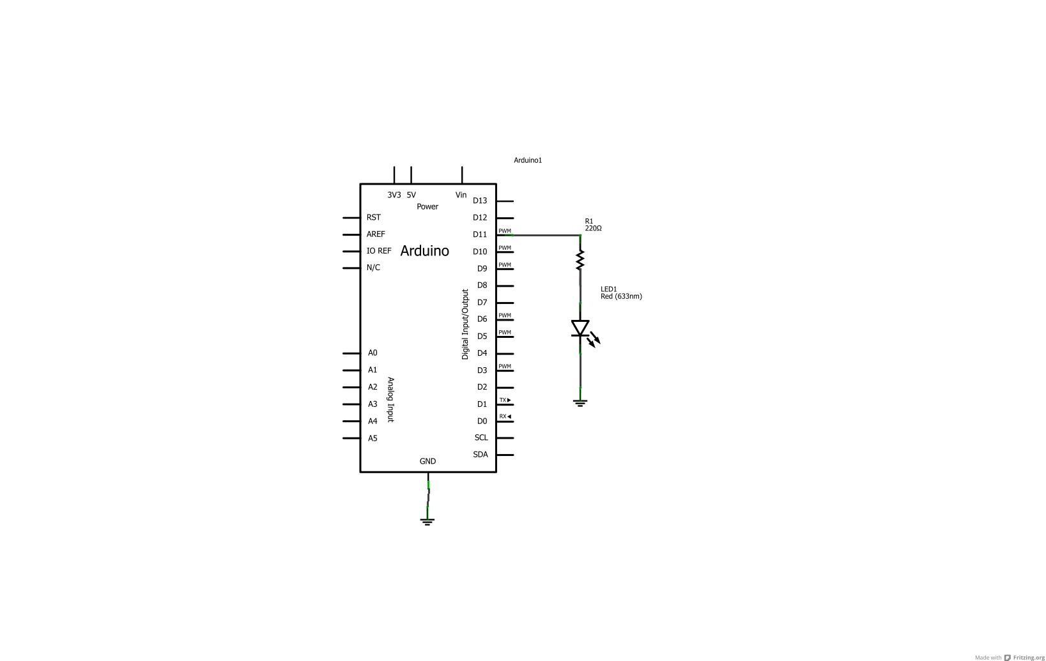
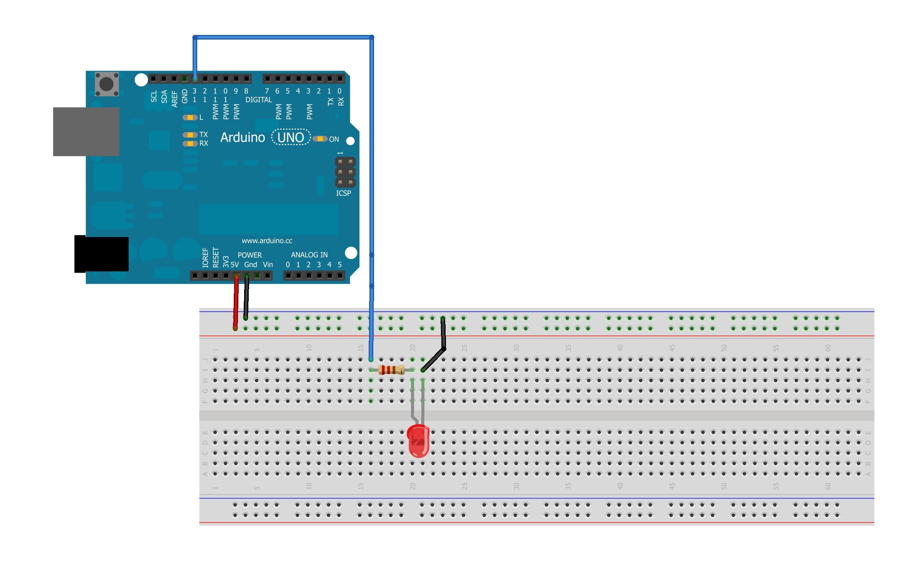
LED3: LED + Arduino Blink LED

Slide 40
Code Structure
/* Blink */
int ledPin = 11; // LED connected to digital pin 11
// The setup() method runs once, when the sketch starts
void setup() {
// initialize the digital pin as an output:
pinMode(ledPin, OUTPUT);
}
// the loop() method runs over and over again,
// as long as the Arduino board has a power supply.
void loop()
{
digitalWrite(ledPin, HIGH); // set the LED on
delay(500); // wait for half second(500ms)
digitalWrite(ledPin, LOW); // set the LED off
delay(500); // wait for half second(500ms)
}
Power On / reset
Initialize Global Variables
setup() function
(run once)
loop() function
(loop forever until the power shut down.)

Slide 41
pinMode(pin);
Description
Configures the specified pin to behave either as an input or an output. See the description of digital pins for details.
Syntax
pinMode(pin, mode)
Parameters
pin: the number of the pin whose mode you wish to set
mode: either INPUT or OUTPUT
Returns
None

Slide 42
pinMode(pin, mode)

Slide 43
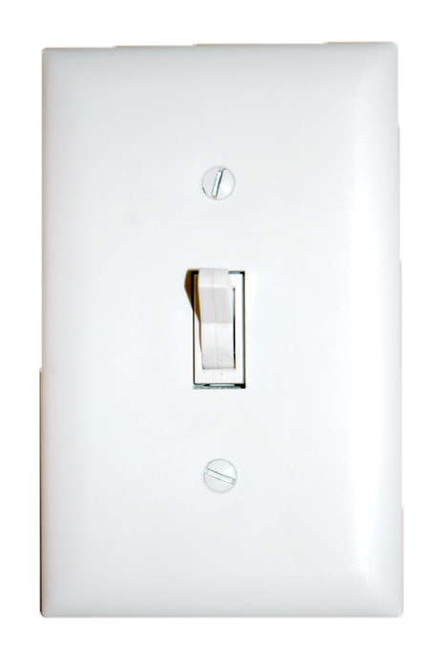

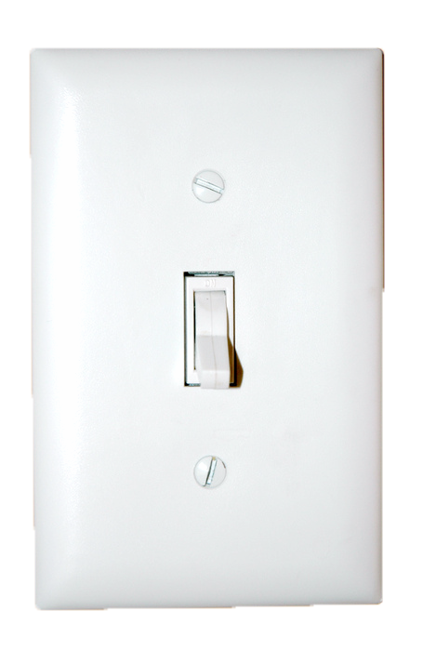
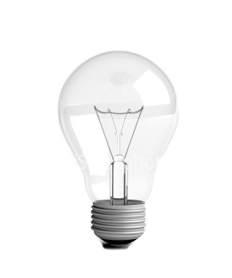
digitalWrite(pin,value)
ON
digitalWrite(pin,HIGH);
5V
internal Pin State
Pin Output
digitalWrite(pin,LOW);
OFF
0V

Slide 44


digitalWrite(pin,value);
ON
digitalWrite(pin,HIGH);
5V
internal Pin State
Pin Output
digitalWrite(pin,LOW);
OFF
0V

Slide 45
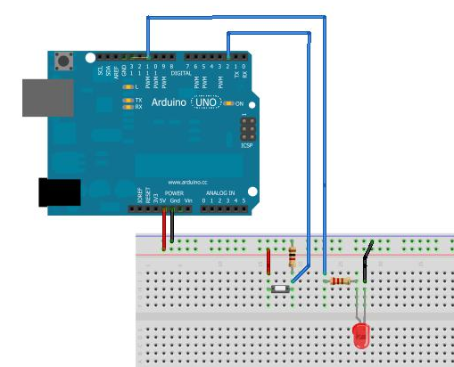
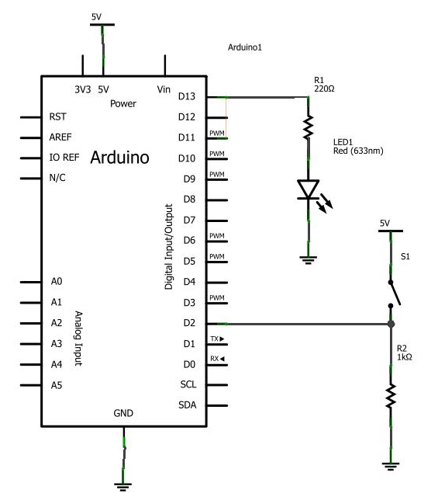
LED4: LED + Button input

Slide 46
Blink + Button input
// Pin 11 has an LED connected on most Arduino boards.
// give it a name:
int led = 11;
// digital pin 2 has a pushbutton attached to it. Give it a name:
int pushButton = 2;
int buttonState = LOW;
// the setup routine runs once when you press reset:
void setup() {
// initialize the digital pin as an output.
pinMode(led, OUTPUT);
pinMode(pushButton, INPUT);
}
// the loop routine runs over and over again forever:
void loop() {
// read the input on ditigal pin 2:
buttonState = digitalRead(pushButton);
digitalWrite(led, buttonState);
delay(100); // wait for a while
}

Slide 47
digitalRead()
Description
Reads the value from a specified digital pin, either HIGH or LOW.
Syntax
digitalRead(pin)
Parameters
pin: the number of the digital pin you want to read (int)
Returns
HIGH or LOW

Slide 48
Fading LED + Button
void loop()
{
buttonRead = digitalRead(buttonPin);
if(buttonRead == LOW){ // check if button pressed
if(fadeValue < 256) fadeValue++; //increment fadeValue
}else if(buttonRead == HIGH){ //if button is not pressed
if(fadeValue > 0) fadeValue--;
}
Serial.println(fadeValue);
analogWrite(ledPin, fadeValue);
// wait for 30 milliseconds to see the dimming effect
delay(30);
}
/*
Blink + Button + Fade
Press Button to Fade Up the LED, Release Button to Fade Out
*/
int ledPin = 9; // LED connected to digital pin 13
int buttonPin = 2; // Button connected to digital pin 2
int buttonRead = LOW; // Button state
int fadeValue = 0; // LED fading brightness
void setup() {
// initialize the digital pin as an output:
pinMode(ledPin, OUTPUT);
pinMode(buttonPin, INPUT);
// initialize Serial commnication port at 9600 bps:
Serial.begin(9600);
//Serial.println("type 1:LED On 2: LED Off");
}

Slide 49
analogWrite()
Description
Writes an analog value (PWM wave) to a pin. Can be used to light a LED at varying brightnesses or drive a motor at various speeds. After a call to analogWrite(), the pin will generate a steady square wave of the specified duty cycle until the next call to analogWrite() (or a call to digitalRead() or digitalWrite() on the same pin). The frequency of the PWM signal is approximately 490 Hz.
On most Arduino boards (those with the ATmega168 or ATmega328), this function works on pins 3, 5, 6, 9, 10, and 11. On the Arduino Mega, it works on pins 2 through 13. Older Arduino boards with an ATmega8 only support analogWrite() on pins 9, 10, and 11. You do not need to call pinMode() to set the pin as an output before calling analogWrite().
The analogWrite function has nothing whatsoever to do with the analog pins or the analogRead function.
Syntax
analogWrite(pin, value)
Parameters
pin: the pin to write to.
value: the duty cycle: between 0 (always off) and 255 (always on).
Returns
nothing

Slide 50
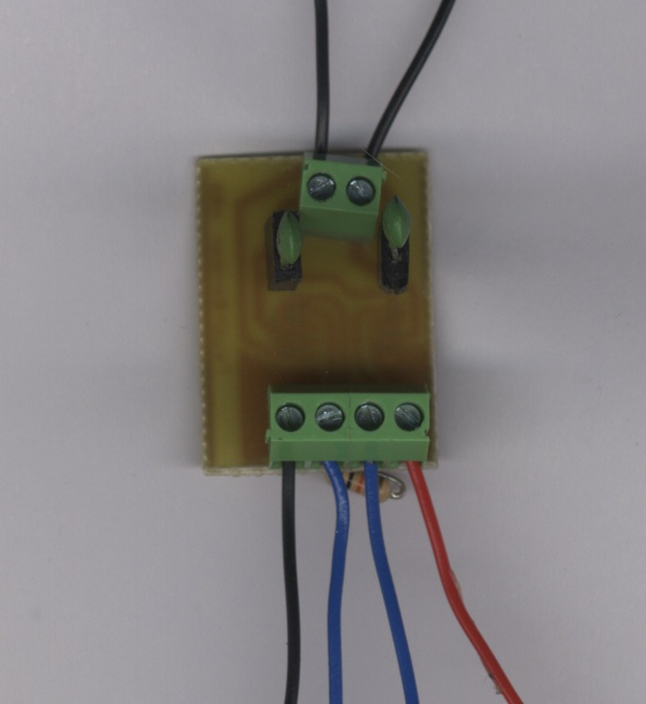
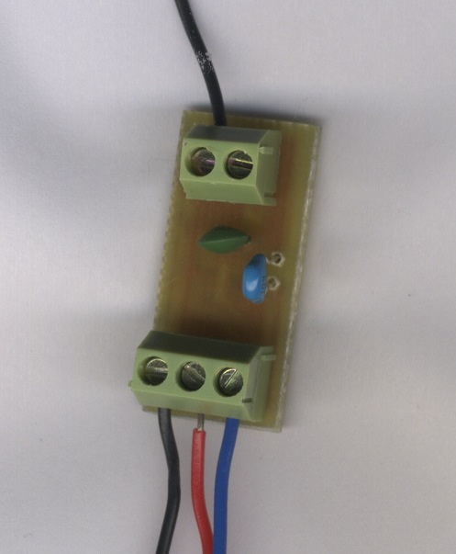
LED4: LED + Touch Sensor
2ch Touch Sensor Module
1ch Touch Sensor Module
5V
GND
GND
5V
DPin2
DPin2

Slide 51
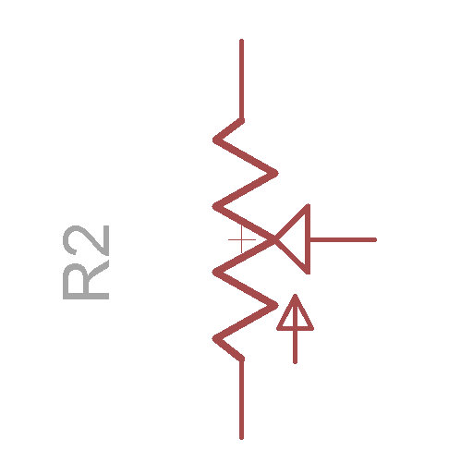
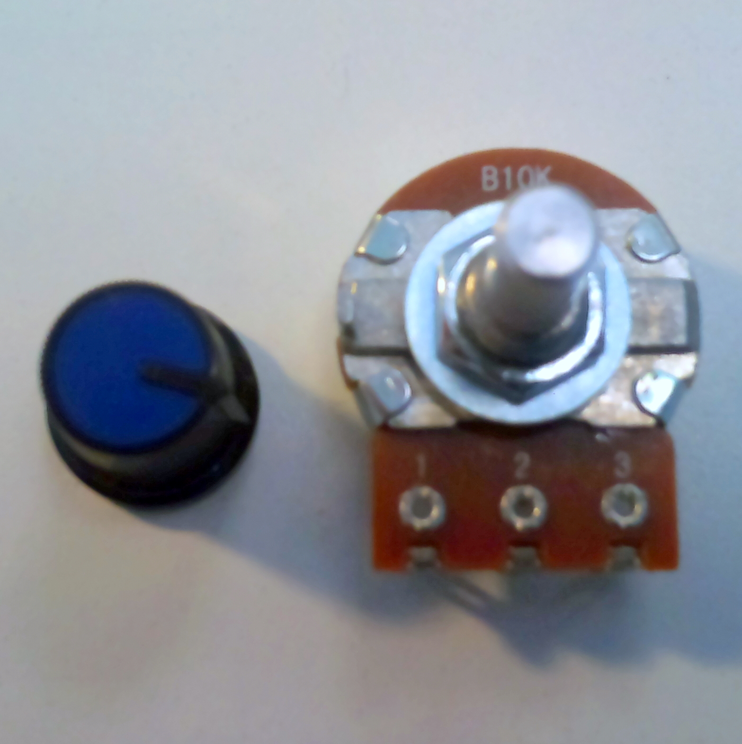
Potentiometer(Variable Resistor)

Slide 52
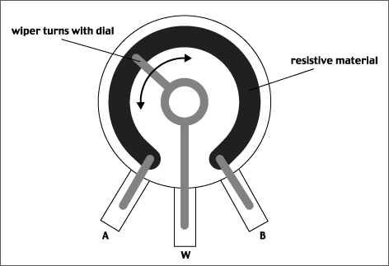
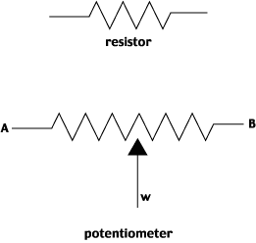



Inside Potentiometer http://fddrsn.net/pcomp/examples/potentiometers.html
0%
50%
100%

Slide 53
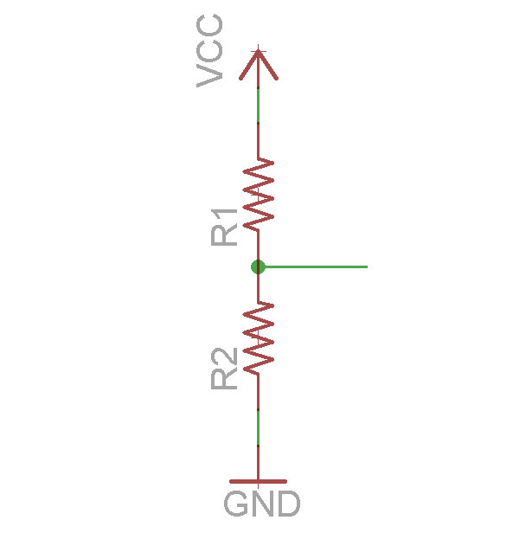
Voltage Divider
Vout =
R2 / (R1 + R2) x Vcc
If R1 = R2?
Vout =
R / (R + R) x Vcc
= 1/2 Vcc
Vout?
Notes:
http://en.wikipedia.org/wiki/Voltage_divider

Slide 54
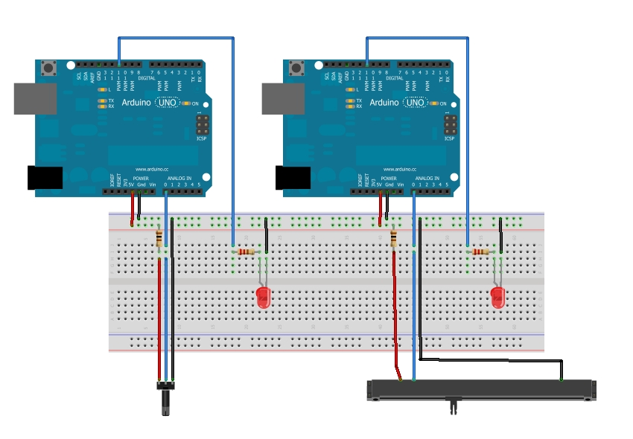
LED4 LED + VR Circuit

Slide 55
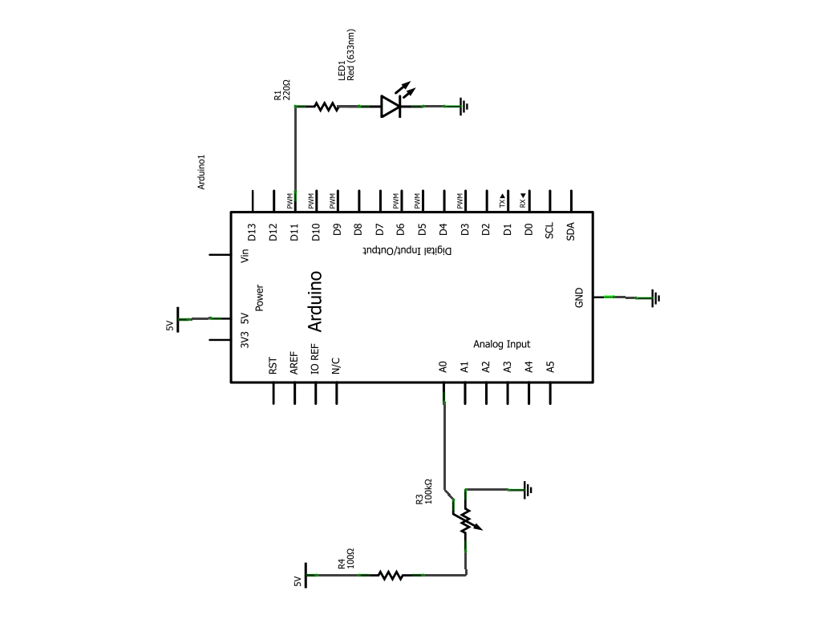
LED4 LED + VR schematic

Slide 56
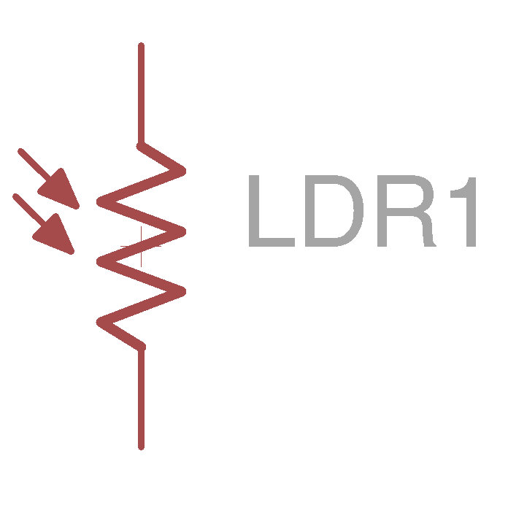
LDR(light sensor)

Slide 57
analogRead(pin)
Description
Reads the value from the specified analog pin. The Arduino board contains a 6 channel, 10-bit analog to digital converter.
This means that it will map input voltages between 0 and 5 volts into integer values between 0 and 1023. This yields a resolution between readings of: 5 volts / 1024 units or, .0049 volts (4.9 mV) per unit.
It takes about 100 microseconds (0.0001 s) to read an analog input, so the maximum reading rate is about 10,000 times a second.
Syntax
analogRead(pin)
Parameters
pin: the number of the analog input pin to read from (0 to 5 on most boards, 0 to 7 on the Mini and Nano, 0 to 15 on the Mega)
Returns
int (0 to 1023)

Slide 58
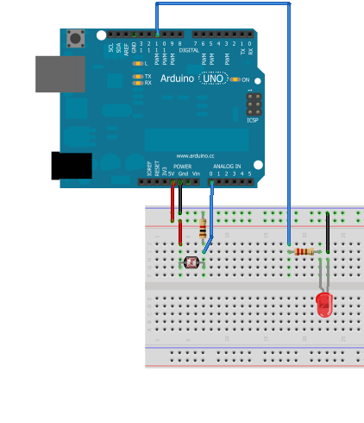
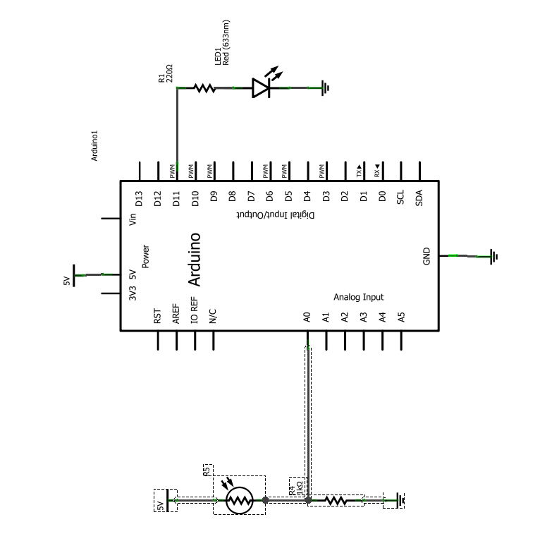
LightSensor(LDR) Input

Slide 59
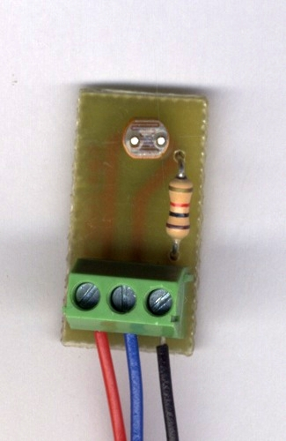
LightSensor(LDR) Input
5V
A0
GND

Slide 60



Assignment: TOYSRUS /Sungei Thief market/ Mustafa Ctr hunting
Purchase a commercial electronic product (Toy/kitchen ware/etc…) which work with batteries or an AC adaptor (not 245V power-line).

Slide 61


Assignment Task:
Open up the product and observe inner-components (electrical/mechanical)
Document the process of deconstruction and create a break down list of components. (and recover back to the original condition, if you can.)

Slide 66


Resistors
Resistor Symbol

Slide 67

Resistor ColorCode
1 : Brown
2 : Red
3 : Orange
4 : Yellow
5 : Green
6 : Blue
7 : Purple
8 : Gray
9 : White
0 : Black
Tolerance
+/- 5% : Gold
+/- 10% : Silver

Slide 68
Reading Color Code
Brown Black Red Gold
1 0 x 10^{2 +/- 5%} = 1000 = 1k Ohm
Yellow Purple Orange Gold
4 7 x 10^{3 +/- 5%} = 47000 = 47k
Brown Black Orange Gold
? ? x 10? ? = ???

Slide 69

How to lit a LED? = How to choose resistor value?
R = (Vs - Vl) / I
What If…
Vs = 9v
Vl = 1.5
I = 20mA(0.02A)
R = (9 – 1.5) / 0.02
= 375 ohm
R
Vs
I
Vl
Notes:
http://www.kpsec.freeuk.com/components/led.htm

Slide 70
How to lit a LED?
Vs = Battery Voltage
Vl = LED forward voltage
R = Resistance
I = LED Current
R
Vs
I
Vl
LED Brightness = I = LED current. Usually 10mA ~ 30mA
Notes:
http://www.kpsec.freeuk.com/components/led.htm

Slide 71
Ohm’s Law
V = IR :
Voltage = Current x Resistance
I = V / R :
Current = Voltage / Resistance
R = V / I :
Resistance = Voltage / Current

